Slide 1
End-to-End Deblurring with Denoising and Saturation Handling
18EC64 : BE Minor Project Final Presentation
Aritra Raychaudhuri 1RV19EC028
Moneet Mohan Devadig 1RV19EC098
Pragya Sen 1RV19EC126
Guide Name: Mahendra BM
Designation: Assistant Professor, Department of ECE, RVCE
Department of Electronics and Communication Engineering

Slide 2

Outline
Go, change the world
RV College of
Engineering
Introduction
Motivation
Problem Statement
Objectives of the project
Literature Survey
Design Theory
Design Methodology
Structural Differences and Advantages
Simulation Results
Experimental Results
Performance Comparison
Analysis of Results
Inferences Drawn
Conclusion
Details of Software/Hardware
Learning Outcomes of the Project
Timeline of the Project
References
*
Department of ECE
‹#›

Slide 3
Introduction
Go, change the world
RV College of
Engineering
Deblurring:
Image blur is a very common occurrence in natural photos, arising from different factors such as object motion, camera lens, out-of-focus, and camera shake.
Generative Adversarial Networks (GAN) have also been studied extensively to solve this problem. Many variants of GAN models have been proposed.
GAN works very well when it comes to dealing with different types of blur including Motion blur, Gaussian Blur, Average Blur, Defocus blur, etc. It works well with both synthetic and natural blur.
Saturation Handling:
Saturation describes the intensity of the color in an image.
Previously, Confidence maps, Robust GANs and ResNet networks have been used for handling outliers while deblurring.
*
‹#›

Slide 4
Introduction
Go, change the world
RV College of
Engineering
Denoising:
Image noise is random variation of brightness or color information in images. Denoising is the process of removing the noise present in images.
It is seen that saturation and noise deeply affects the performance of deblurring networks. Motion blur and signal noise are the most important factors which causes image degradation.
Traditional denoising methods such as Denoising Autoencoders are better than learning-based methods (such as GAN and CNN).
The goal is to realise a new and improved model for end-to-end deblurring in combination with denoising networks that can achieve favourable values of image quality metrics (such as SSIM and PSNR) and handle outliers like saturated pixels during the process.
*
‹#›

Slide 5
Motivation
Go, change the world
RV College of
Engineering
Existing deblurring techniques do not deal with outlier handling and denoising.
In existing methods, satisfactory results for blurred images with outliers have been obtained only when many constraints are placed on the amount and nature of blur or noise.
GAN is known to produce better results with respect to deblurring as compared to other existing CNN models.
This project deals with realizing an optimal model that can deblur an image, while also removing the noise and saturation in the image.
*
Department of ECE
‹#›

Slide 6
Problem Statement
Go, change the world
RV College of
Engineering
Deblurring and Denoising images with outliers using the help of an optimum GAN module.
*
Department of ECE
‹#›

Slide 7
Objectives of the Project
Go, change the world
RV College of
Engineering
To use the optimum GAN module for deblurring images.
To handle outliers (eg: saturation) while deblurring.
To use traditional denoising networks for image denoising.
To combine all the three architectures to obtain the final working model.
*
Department of ECE
‹#›

Slide 8
Literature Survey
Go, change the world
RV College of
Engineering
Sl No | Paper Title, Journal Name, Year | Major findings / observations
1 | Blind Motion Deblurring Super-Resolution: When Dynamic Spatio-Temporal Learning Meets Static Image Understanding - IEEE Transactions on Computational Imaging, 2021 | Recovering sharp high-resolution images from motion-blurred low-resolution input. It models the reverse process of generation of motion-blurred images. Three-streams network to recover the final sharp high-resolution images.
2 | Deep Multi-Scale Feature Learning for Defocus Blur Estimation – IEEE TRANSACTIONS ON IMAGE PROCESSING, 2021 | CNN that tackles depth images from pattern edges. Multi-scale blur estimation for pattern edges that uses input patches with varying sizes. A fast edge-aware guided filter to propogate blur information estimated at pattern edge points.
*
Department of ECE
‹#›

Slide 9
Literature Survey
Go, change the world
RV College of
Engineering
Sl No | Paper Title, Journal Name, Year | Major findings / observations
3 | Beyond Camera Motion Blur Removing: How to Handle Outliers in Deblurring - IEEE Transactions on Computational Imaging, 2021 | A dataset synthesis approach that considers outliers. Edge aware scale recurrent net consisting of a deblurring part and an upsampling part. Salient edge selection network to supervise the deblurring process.
4 | Blur, Noise, and Compression Robust Generative Adversarial Networks - 2021 IEEE/CVF Conference on Computer Vision and Pattern Recognition (CVPR), 2021 | BNCR GAN that can learn a clean image generator from degraded images without knowledge of degradation parameters. Degradation based models performed better with LPIPS and FID metrics.
*
Department of ECE
‹#›

Slide 10
Literature Survey
Go, change the world
RV College of
Engineering
Sl No | Paper Title, Journal Name, Year | Major findings / observations
5 | Deep Outlier Handling for Image Deblurring - IEEE Transactions on Image Processing, 2021 | Deep convolutional neural network to directly estimate the confidence map. Identify reliable inliers and outliers and facilitate the deblurring process. Can be applied to both non-blind and blind image deblurring.
6 | Handling Outliers by Robust M-Estimation in Blind Image Deblurring - IEEE Transactions on Multimedia, 2021 | Proposes a blind motion deblurring method for blurred images including light streaks. Uses Huber’s M-estimation method. Solves the problems of false detection of candidate light streaks and optimal light streak in existing methods.
*
Department of ECE
‹#›

Slide 11
Literature Survey
Go, change the world
RV College of
Engineering
Sl No | Paper Title, Journal Name, Year | Major findings / observations
7 | Noise Robust Generative Adversarial Networks - 2020 IEEE/CVF Conference on Computer Vision and Pattern Recognition (CVPR), 2020 | Noise generator captures only noise-specific components. Different variants for signal dependent and signal independent noise. Better PSNR values on LSUN BEDROOM and FFHQ.
8 | UID-GAN: Unsupervised Image Deblurring via Disentangled Representations - IEEE Transactions on Biometrics, Behavior, and Identity Science, 2020 | Unsupervised method for blind image deblurring without paired trained images. Improved deblurring performance by splitting content and blur features.
*
Department of ECE
‹#›

Slide 12
Literature Survey
Go, change the world
RV College of
Engineering
Sl No | Paper Title, Journal Name, Year | Major findings / observations
9 | CycleGAN With a Blur Kernel for Deconvolution Microscopy: Optimal Transport Geometry – IEEE Transactions on Computational Imaging, 2020 | Unsupervised cycle-consistent GAN with a linear blur kernel. Used for both blind and non-blind image deconvolution. Improved efficiency and robustness compared to novel CycleGAN frameworks.
10 | Blind Deblurring of Saturated Images Based on Optimization and Deep Learning for Dynamic Visual Inspection on the Assembly Line – Symmetry , 2019 | The blur kernel is estimated via features selected from the transform domain. Deconvolution iteratively performs deblurring and denoising. Deblurring aims at rejecting outliers and denoising is performed using CNN.
*
Department of ECE
‹#›

Slide 13
Literature Survey
Go, change the world
RV College of
Engineering
Sl No | Paper Title, Journal Name, Year | Major findings / observations
11 | Deep Multi-scale Convolutional Neural Network for Dynamic Scene Deblurring – CVPR , 2017 | A multi-scale CNN that directly restores latent images without blur kernel model A multi-scale loss that is appropriate for coarse-to-fine architecture. A new realistic blurry image dataset with ground truth sharp images.
12 | Deep non-blind deconvolution via generalized low-rank approximation- NIPS, 2018 | Establishing the connection between optimization schemes and CNNs. Separable structure of kernels to initialise the weights in the network used to generate blur kernels. Unified deconvolution network.
*
Department of ECE
‹#›

Slide 14
Literature Survey
Go, change the world
RV College of
Engineering
Sl No | Paper Title, Journal Name, Year | Major findings / observations
13 | DeblurGAN: Blind Motion Deblurring Using Conditional Adversarial Networks – 2018 IEEE/CVF Conference on Computer Vision and Pattern Recognition (CVPR), 2018 | Multicomponent loss function is used along with Conditional GAN. Deblurring is treated as image-to-image translation. Deblur GAN has higher F1 and recall scores than competitors.
14 | GAN-Based Image Deblurring Using DCT Loss With Customized Datasets - IEEE Access, 2021 | DCT based loss to preserve texture and suppress ringing artifacts in restored images. DCT loss compares the restored image and ground truth image in frequency domain. Highest performances in terms of PSNR, SSIM, and running time compared with conventional methods.
*
Department of ECE
‹#›

Slide 15
Literature Survey
Go, change the world
RV College of
Engineering
Sl No | Paper Title, Journal Name, Year | Major findings / observations
15 | Deep Pyramid Generative Adversarial Network With Local and Nonlocal Similarity Features for Natural Motion Image Deblurring - IEEE Access, 2019 | Deep pyramid generative adversarial network called LNL-PGAN which deals with motion image deblurring. Obtains nonlocal and local similarity features at multiple levels. Captures short range and long range dependencies to improve the network representation ability.
16 | Edge Heuristic GAN for Non-Uniform Blind Deblurring - IEEE Signal Processing Letters, 2019 | A lightweight GAN to generate heuristic edges. Uses the coarse-to-fine scheme to restore clear images in an end-to-end manner. Contains a modified encoder-decoder network and ResBlocks to handle complicated motion blur.
*
Department of ECE
‹#›

Slide 16
Literature Survey
Go, change the world
RV College of
Engineering
Sl No | Paper Title, Journal Name, Year | Major findings / observations
17 | Motion Blur Kernel Estimation via Deep Learning - IEEE Transactions on Image Processing, 2018 | Consists of two stages: suppressing extraneous details and enhancing sharp edges. Does not require any coarse-to-fine strategy or edge selection. Significantly reduces computation load by simplifying kernel estimation.
18 | Improved Deep Multi-Patch Hierarchical Network With Nested Module for Dynamic Scene Deblurring - IEEE Access, 2020 | Nested module blocks are substituted, whose powerful and complex representation ability is utilized to improve the deblurring performance. Attention mechanism is introduced to enable the network to differentiate blur across the whole blurry image from dynamic scene.
*
Department of ECE
‹#›

Slide 17
Literature Survey
Go, change the world
RV College of
Engineering
Sl No | Paper Title, Journal Name, Year | Major findings / observations
19 | FFDNet: Towards a Fast and Flexible Solution for CNN based Image Denoising - IEEE Transactions on Image Processing, 2018 | Fast, flexible, efficient, and effective, takes tunable noise level map as input. Works with wide range of noise levels. Achieves good tradeoff between speed and performance.
20 | Beyond a Gaussian Denoiser: Residual Learning of Deep CNN for Image Denoising - IEEE Transactions on Image Processing, 2017 | Works well with Gaussian noise with unknown noise level. Uses residual learning and batch normalization.
*
Department of ECE
‹#›

Slide 18
Literature Survey
Go, change the world
RV College of
Engineering
Sl No | Paper Title, Journal Name, Year | Major findings / observations
21 | SSIM Compliant Modeling Framework With Denoising and Deblurring Applications - IEEE Transactions on Image Processing, 2021 | SSIM has a non-convex nature making it difficult to be employed in model based applications like denoising, etc. Proposes a process of obtaining a generalised convex framework.
*
Department of ECE
‹#›

Slide 19
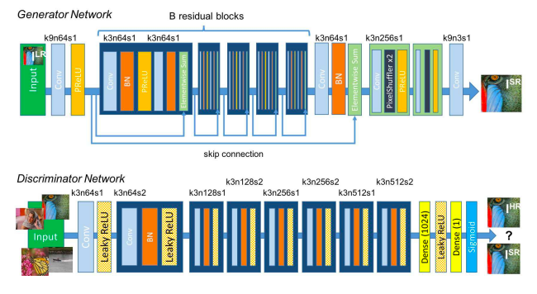
Design Theory
SRGAN (Super Resolution General Adversarial Network) for deblurring image
The proposed GAN architecture for image deblurring is called Super Resolution GAN.
The generator uses Resnet blocks, which is composed of convolutional layer, batch normalization, Parametric Rectified Linear Unit (PReLu).
The discriminator has the same blocks, but instead of PReLU, uses Leaky ReLu.

Slide 20
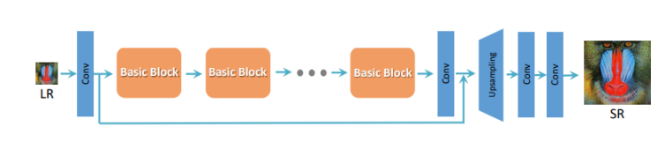
Design Theory
Saturation Handling
Regular ESRGAN architecture
The proposed architecture for handling saturation is called Enhanced Super Resolution GAN (ESRGAN).
Batch Normalization (BN) layers are removed.
Using VGG features before activation helps generator recover more realistic texture details.
Network interpolation of ESRGAN and PSNR model for removing unpleasant noise while maintaining good perceptual quality.

Slide 21
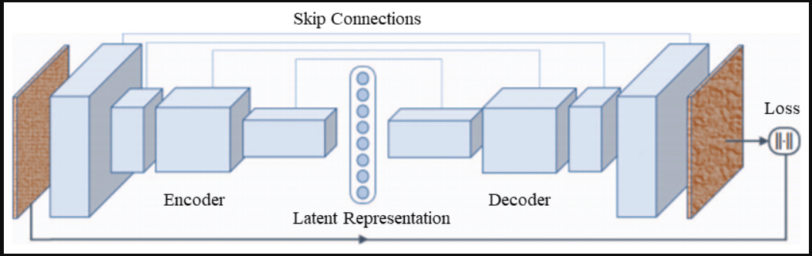
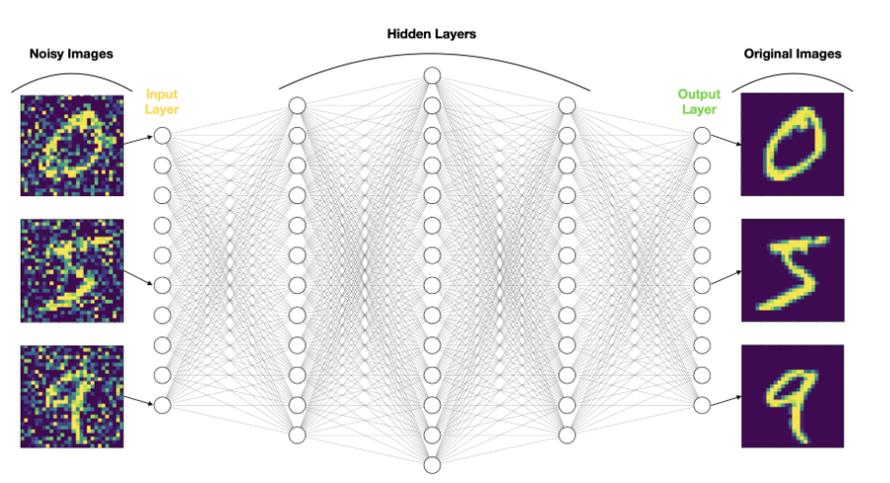
Design Theory
Denoising Autoencoders(DAE):
Purpose of a DAE : to remove noise.
You can also think of it as a customised denoising algorithm tuned to your data.
DAE gets noisy image as input and returns the denoised image
Using skip connections improves the performance of the network

Slide 22
Design Methodology
Go, change the world
RV College of
Engineering
Selecting the most appropriate dataset for the problem statement. This involves choosing a dataset with images that have blur, saturation, and noise.
Choosing the appropriate GAN architecture in order to deblur the input image.
Choosing the best saturation handling method which can run in parallel with deblurring and denoising networks.
Choosing an appropriate image denoising model for cleaning the output image.
Combining all the three architectures to develop a model which is able to deblur the image, handle saturation, and denoise the image.
Department of ECE
‹#›

Slide 23
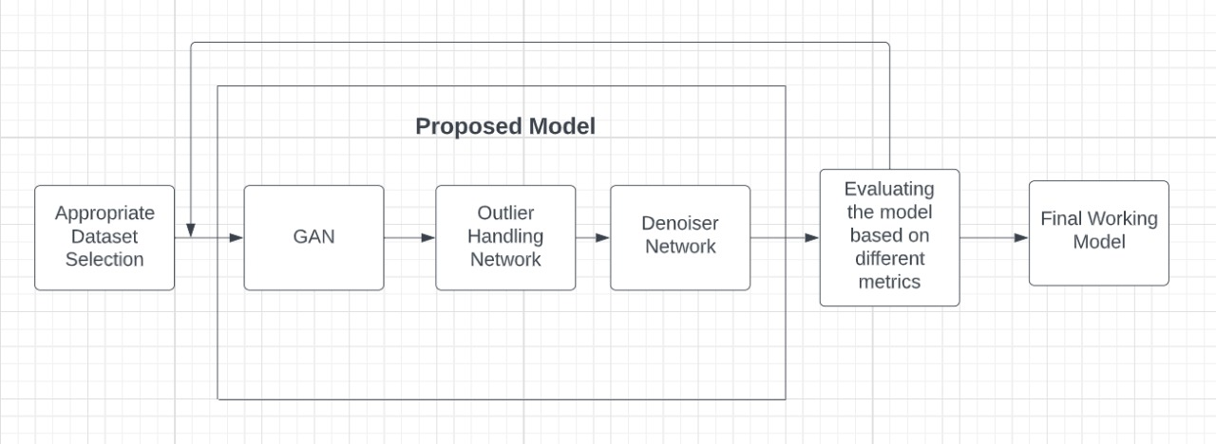
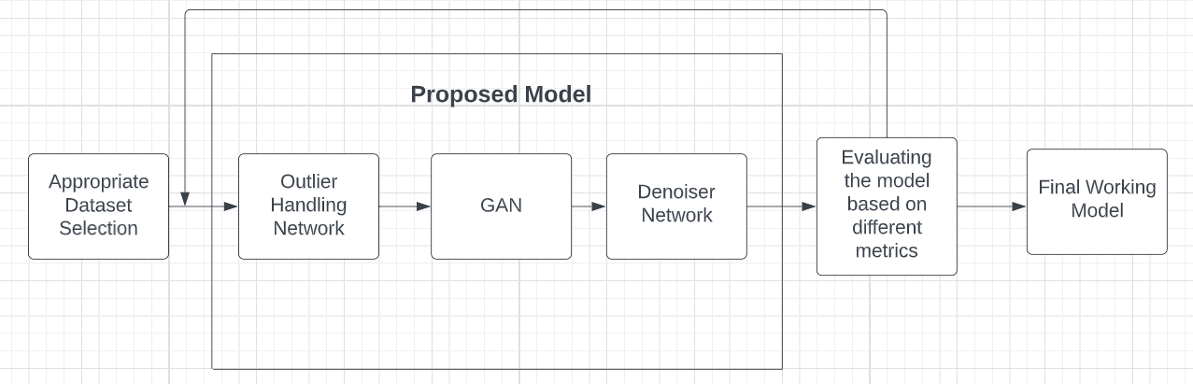
Design Methodology
Proposed Architecture

Slide 24
Design and Implementation
The three architectures have been written using the help of python language.
The frameworks used are OpenCV, Tensorflow, and Keras.
OpenCV is a python library for solving computer vision problems. Here, it is used for reading the images that have to be worked on.
Tensorflow framework is used for accessing the training and inference of neural networks.
Keras provides the python interface for Tensorflow.
The software used for implementing SRGAN, ESRGAN, and DAE is Google Colab.

Slide 25
Structural Differences and Advantages
SRGAN for image deblurring:
Like other GAN architectures, SRGAN also consists of the Generator and Discriminator blocks. The generator produces an image and the discriminator tried to guess whether the image fed to it is the original image or the false image from the generator.
Generator tries to optimise the generated data so that it can fool the discriminator.
The number of layers in both the discriminator and the generator are increased.
For calculating content loss, VGG 19 is used as compared to VGG 22 in most papers. 19 means that 19 convolutional layers are used to calculate the loss. This reduces the parameters trained while also achieving similar results.
Based on the output of the discriminator, two cases were considered, one where the discriminator was not allowed to train, and the other where the discriminator was allowed to train. It was found that the latter was producing more favorable results.

Slide 26
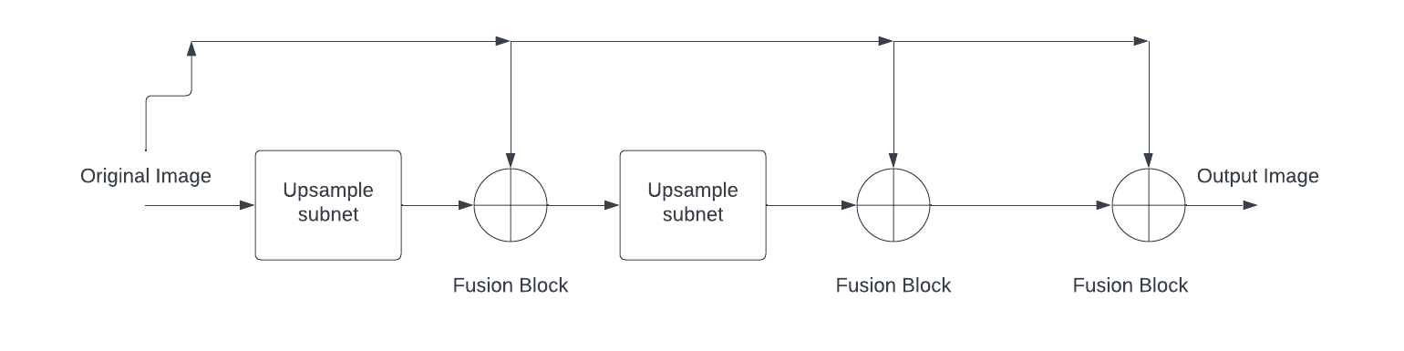
Structural Differences and Advantages
Saturation Handling
ESRGAN was modified to get the desired output.
A fusion block was added to ESRGAN, i.e, upsample subnet+fusion block.
The combined upsampled subnet+fusion block structure was layered to produce better results.
A third fusion block was added to reduce noise generated in the last two layers.
In the first fusion block, weight given to high resolution image was 0.6 and low resolution image was given 0.4.
In the second fusion block, both high resolution and low resolution images were given 0.5 weightage.
In the third fusion block, both high resolution and low resolution images were given 0.5 weightage.

Slide 27
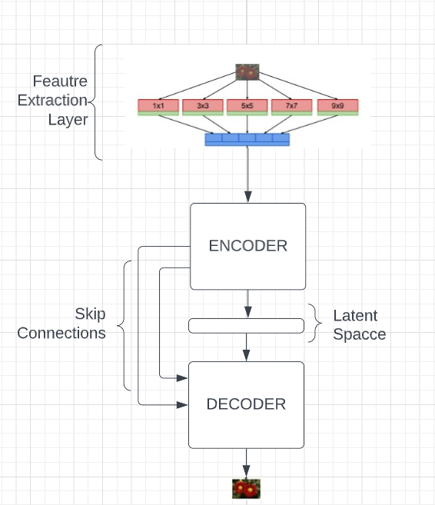
Structural Differences and Advantages
Denoising Autoencoders(DAE):

Slide 28
Structural Differences and Advantages
Denoising AutoEncoders (DAE):
The conventional denoising autoencoders are generally shallower in nature.
Through analysis the superiority of the model with the skip connections is verified hence we can say that the performance of the model is improved.
The loss function used in the previous model was “mse ” but through analysis we came to the conclusion that “Binary cross entropy” as a loss function results in smoother convergence of the validation and training loss.
Additionally a feature extraction layer is added to DAE to which image is fed.
Instead of directly giving the image as input to network ,features are extracted from the input image and is fed to the network.

Slide 29
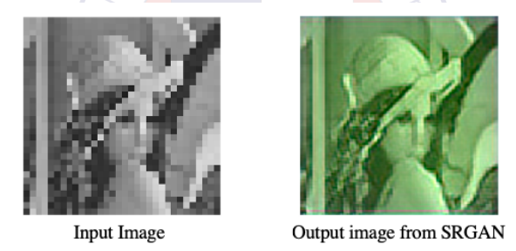
Result
SRGAN (Image generated after training the model on 6777 images, and running the model for 10 epochs)

Slide 30
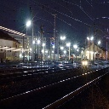
Result
ESRGAN
Input Image

Slide 31
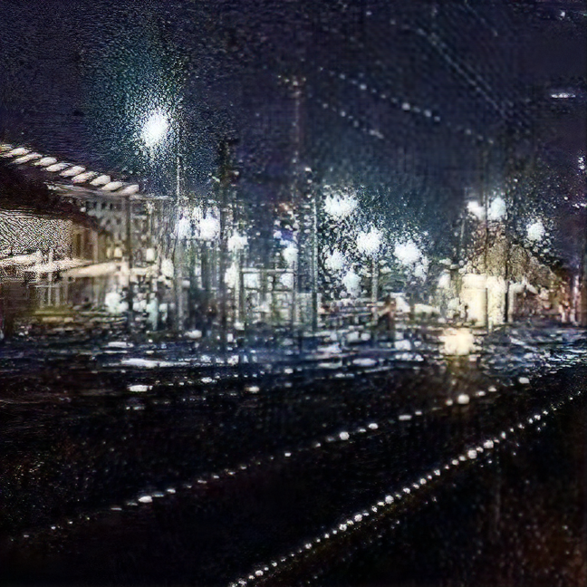
Result
Output of ESRGAN

Slide 32
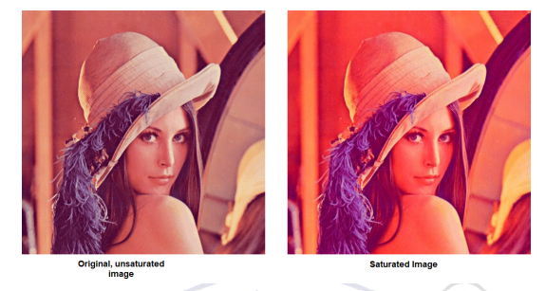
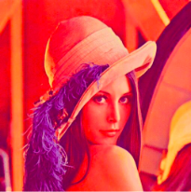
Result
ESRGAN

Slide 33
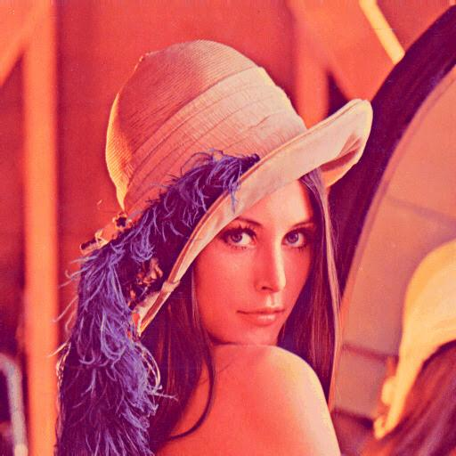
Result
Output of ESRGAN

Slide 34
Result
Output of ESRGAN
Saturated image

Slide 35
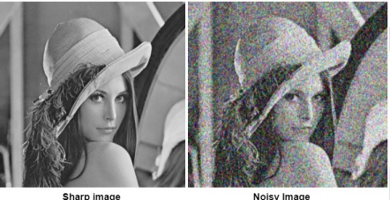
Result
Denoising Auto Encoder
Sharp Image
Noisy Image

Slide 36
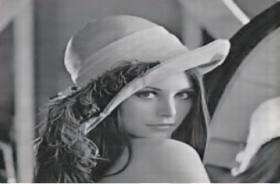

Result
Output of DAE without skip connections and without feature extraction layer

Slide 37
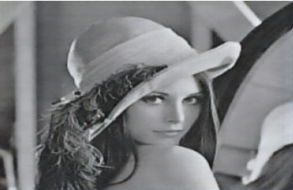
Result
Output of DAE without feature extraction layer

Slide 38
Result
Output of DAE when input is fed to feature extraction layer

Slide 39
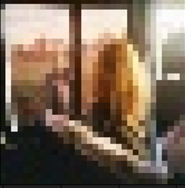
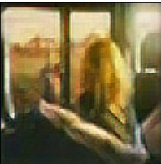
Result
Input image

Slide 40
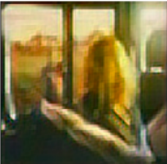
Result
After passing through SRGAN (for 10 epochs)

Slide 41
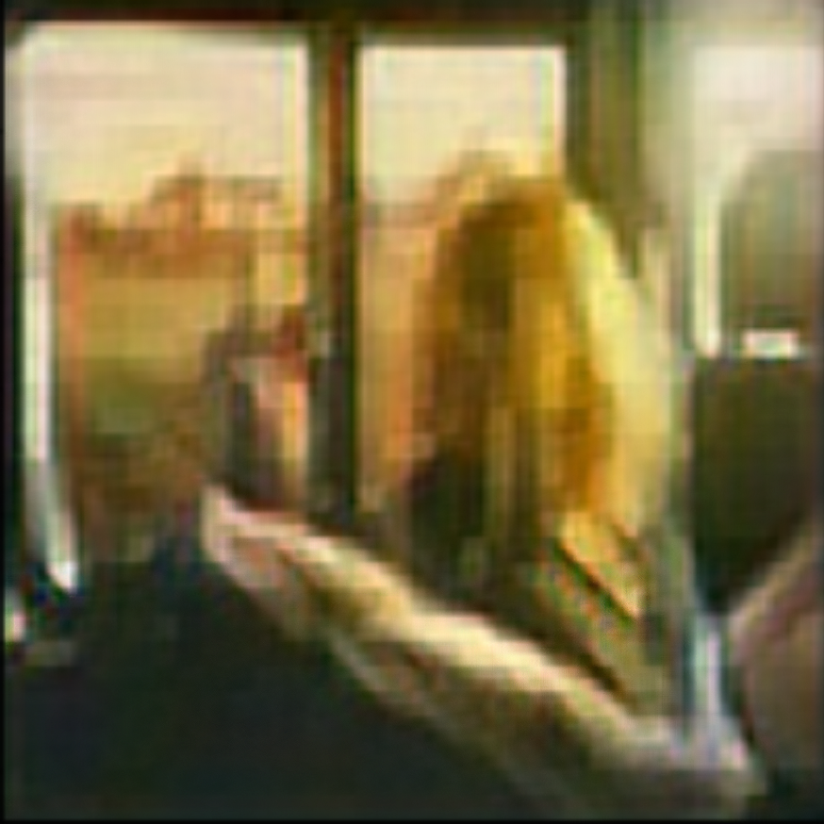
Result
After passing through
Saturation Handling Network

Slide 42
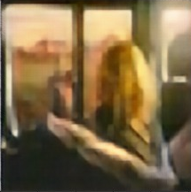
Result
Final Output After Denoising

Slide 43
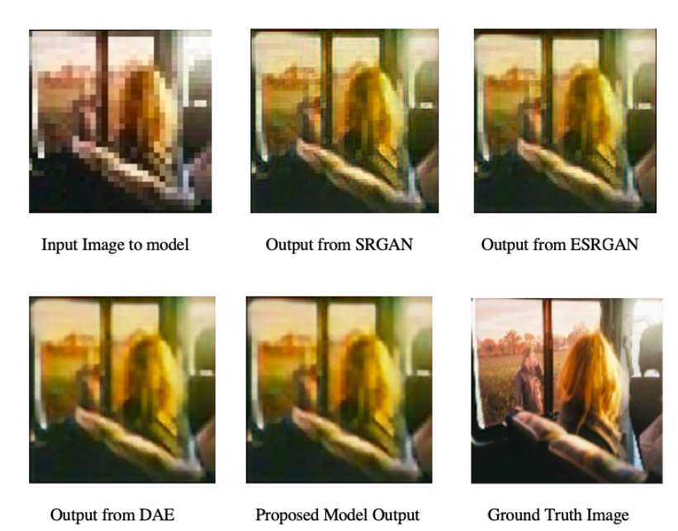
Result
Comparison

Slide 44
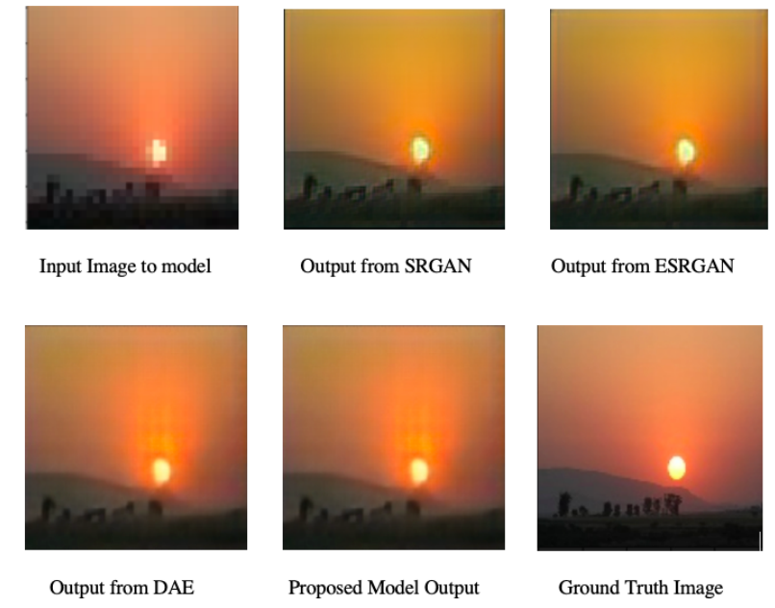
Result
Comparison

Slide 45
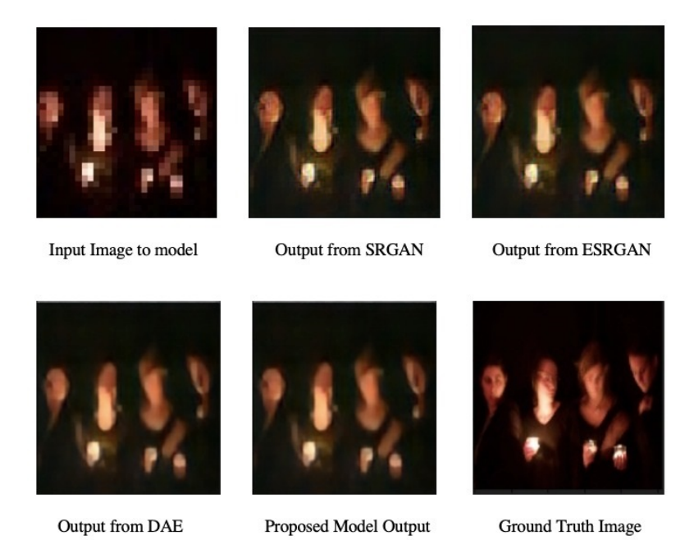
Result
Comparison

Slide 46
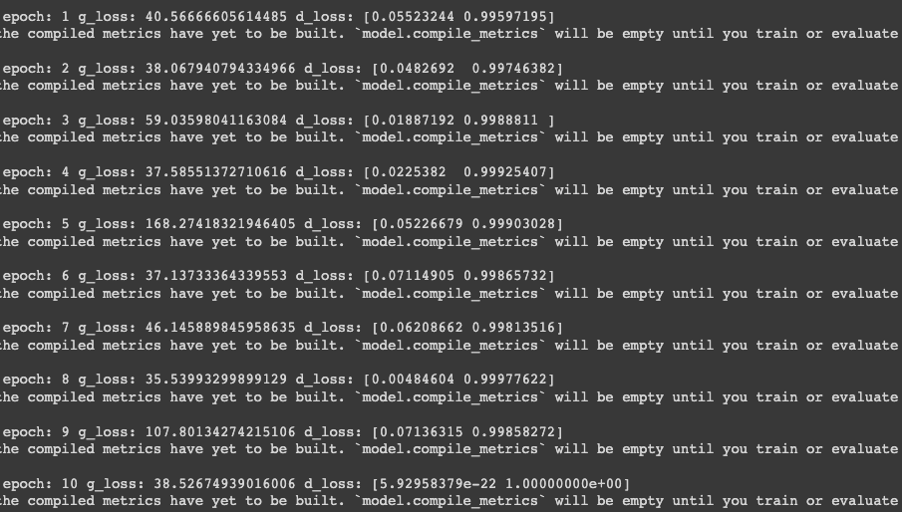
Experimental Results
SRGAN:
Generator and discriminator losses for SRGAN

Slide 47
Experimental Results
SRGAN:
Comparison of SRGAN parameters before and after modification
Parameters | SRGAN
 | Original | After Modification
Total Parameters | 38, 249, 281 | 42, 619, 140
Trainable Parameters | 1, 003, 712 | 2, 040, 067
Non-Trainable Parameters | 37, 245, 569 | 40, 579, 073

Slide 48
Performance Comparison
SRGAN:
Comparison of PSNR and SSIM after running SRGAN for 5 epochs and 10 epochs for both the Original SRGAN and Modified SRGAN
Metrics | Original SRGAN |  | Modified SRGAN(10 Epochs)
 | After 5 Epochs | After 10 Epochs
PSNR (image 1) | 50.43 | 53.003 | 54.64
SSIM (image 1) | 0.995 | 0.998 | 0.999
PSNR (image 2) | 51.67 | 52.46 | 53.07
SSIM (image 2) | 0.994 | 0.999 | 0.999
PSNR (image 3) | 51.997 | 52.60 | 53.09
PSNR (image 4) | 0.993 | 0.999 | 0.999
Average PSNR | 51.99 | 52.69 | 53.60
Average SSIM | 0.994 | 0.999 | 0.999

Slide 49
Analysis of Results
Image Deblurring (SRGAN):
It is seen that higher the number of training images, lower is the generator and discriminator losses.
By increasing the number of epochs, both generator and discriminator losses can be significantly reduced, which helps in creating a much more optimised GAN model.
The number of trainable parameters decrease in the modified SRGAN model.
The PSNR values increase as the number of epochs increases, indicating that the picture quality increases. Even the SSIM values increases marginally. The SSIM values are in the order of 0.99, indicating near to perfect structural similarity.
It is seen that in the modified SRGAN model, the PSNR values increase indicating better performance. SSIM values are in the order of 0.99.

Slide 50
Experimental Results and Performance Comparison
ESRGAN
PSNR and SSIM values at each stage of ESRGAN modification
Intermediate model: Double-layer of ESRGAN and addition of a fusion block after each layer
Metrics | Individual Models
 | Original Model | Intermediate Model | Final Model
PSNR (image 1) | 29.75 | 29.83 | 29.96
SSIM (image 1) | 0.57 | 0.65 | 0.70
PSNR (image 2) | 35.03 | 35.54 | 36.21
SSIM (image 2) | 0.92 | 0.94 | 0.96
PSNR (image 3) | 33.12 | 33.21 | 33.40
SSIM (image 3) | 0.68 | 0.69 | 0.75
Average PSNR | 32.64 | 32.86 | 33.19
Average SSIM | 0.72 | 0.76 | 0.80

Slide 51
Analysis of Results
Saturation Handling:
In Super Resolution, removing batch normalisation layers produces better results.
Two layer GAN structure produces better visual quality results than single layered structure but can lead to decrease in PSNR (increase in noise).
Fusion blocks are helpful in improving PSNR values.
Giving different weights to images in the first fusion block produced better results than giving same weights in all fusion blocks.

Slide 52
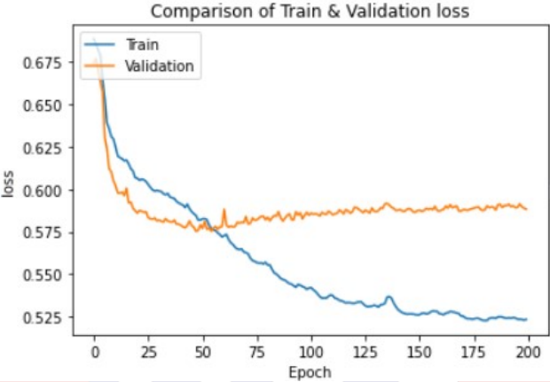
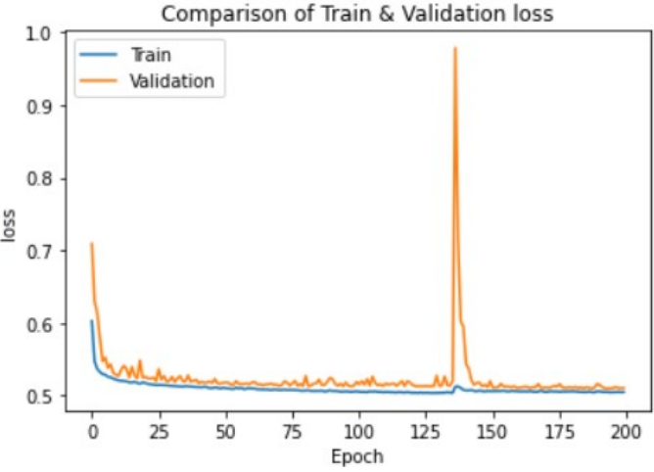
Experimental Results
Denoising Network
Training and validation loss without skip connections
Training and validation loss with skip connections

Slide 53
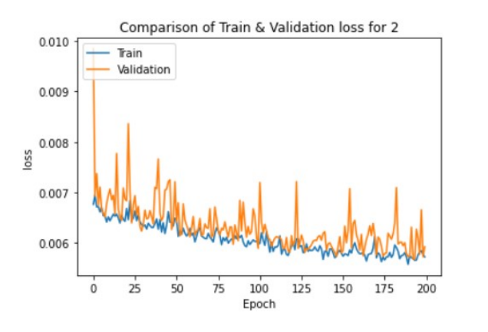
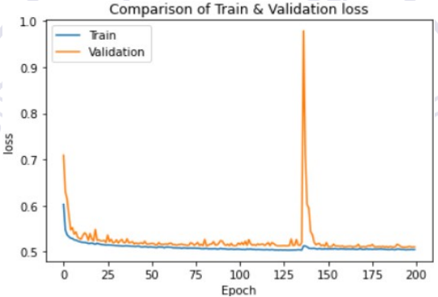
Experimental Results
Training and validation loss for “mse” loss function
Training and validation loss for “Binary cross entropy” loss function

Slide 54
Experimental Results
Comparison of Autoencoder parameters before and after modification
Parameters | Autoencoder
 | Original | After Modification
Total Parameters | 6, 620, 419 | 6, 730, 819
Trainable Parameters | 6, 619, 651 | 6, 730, 051
Non-Trainable Parameters | 768 | 768

Slide 55
Performance Comparison
Denoising Network:
Comparison of PSNR and SSIM for the Denoising network
Metrics | Denoising Autoencoder
 | Without Feature Extraction Layer | With Feature Extraction Layer
PSNR (image 1) | 32.78 | 33.55
SSIM (image 1) | 0.57 | 0.59
PSNR (image 2) | 31.75 | 30.42
SSIM (image 2) | 0.89 | 0.87
PSNR (image 3) | 30.93 | 31.12
PSNR (image 4) | 0.86 | 0.90
Average PSNR | 31.82 | 31.70
Average SSIM | 0.77 | 0.79

Slide 56
Analysis of Results
Denoising Networks:
Denoising network with the skip connections produced better results in terms of visual quality hence we can say that the performance of the model is improved.
“Binary cross entropy” as a loss function results in smoother convergence of the validation and training loss compared to the “mse” loss function.
Addition of feature extraction layer improves the model performance but increases the
number of trainable parameters.

Slide 57
Performance Comparison
Proposed Model
PSNR and SSIM values after each stage in the proposed model
Metrics | Individual Models |  |  | Proposed Model
 | After SRGAN | After ESRGAN | After DAE
PSNR (image 1) | 54.64 | 34.36 | 35.36 | 35.36
SSIM (image 1) | 0.99 | 0.87 | 0.88 | 0.88
PSNR (image 2) | 53.07 | 36.34 | 34.97 | 34.97
SSIM (image 2) | 0.99 | 0.93 | 0.91 | 0.91
PSNR (image 3) | 53.09 | 33.64 | 35.34 | 35.34
SSIM (image 3) | 0.99 | 0.86 | 0.91 | 0.91
Average PSNR | 53.60 | 34.78 | 35.22 | 35.22
Average SSIM | 0.99 | 0.89 | 0.90 | 0.90

Slide 58
Inferences Drawn
SRGAN:
It is seen that in SRGAN, the PSNR values increase as the number of epochs increases, indicating that the picture quality increases.
The SSIM values increases marginally. The SSIM values are in the order of 0.99, indicating near to perfect structural similarity.
Modified SRGAN model has increased number of layers in both the generator and discriminator blocks. The PSNR values increases which indicates that picture quality is much better. SSIM values still remain in the order of 0.99.
ESRGAN:
The modified model has 2 layers of ESRGAN and a fusion block after each layer and a final fusion block after that, thus creating a total of 3 fusion blocks which has significantly improved the performance of the original ESRGAN model.
The PSNR and SSIM values are better for the modified model.
The degree of saturation in images is better in the output produced by the modified model.

Slide 59
Inferences Drawn
Autoencoder:
The PSNR and SSIM values of the Denoising Auto Encoder with and without the feature extraction layer is compared.
It can be inferred from the values that Feature Extraction Layer improves the performance of the Denoising network even though the visual appeal appears similar.
Proposed model:
Finally, the PSNR and SSIM values of the images after passing through each network, one after the other is compared.
By comparing the visual quality of the output images along with the PSNR, SSIM values, it can be seen that the proposed model is performing better than the original, individual models being used.
The blur, noise and saturation levels have significantly reduced as compared to the original input images passed through the proposed model.

Slide 60
Analysis of Result
The output of our model is able to deblur the input image, handle the saturation, and denoise the image as well.
Here, the output image is not as sharp as the ground truth image.
As a consequence of hardware limitations, SRGAN could be run only for 10 epochs. By increasing the number of epochs, the output image would have been much sharper.
The saturation handling network is able to take care of the saturation, as seen in the images.
The Denoising Autoencoder is also able to successfully able to reduce the amount of noise present in the images.

Slide 61
Conclusion
In this work, we solved the problem of image deblurring, saturation handling, and denoising by breaking down the problem into three sub-problems.
We have proposed a three-stage architecture which contains three unique parts, i.e. image deblurring, saturation handling, and image denoising.
All three models were trained independently to optimise their performance.
For deblurring of images, a variant of Generative Adversarial Networks known as Super Resolution GAN is used.
The deblurred image is then passed on to modified ESRGAN to handle the outliers present in the deblurred image.
The image while passing through the deblurring and saturation handling network acquires noise which is denoised by the Convolutional Denoising Autoencoders.

Slide 62
Learning Outcomes of the Project
Go, change the world
RV College of
Engineering
Gained in depth knowledge about the process of image deblurring
Understood and implemented state of the art GAN models
Understood and implemented state of the art saturation handling networks and made improvements to them.
Understood and implemented state of the art Image denoising architecture and were able to modify it.
Learnt tensorflow framework.
*
Department of ECE
‹#›

Slide 63

Go, change the world
RV College of
Engineering
Timeline of the Project
 | April 2022 |  |  |  | May 2022 |  |  |  | June 2022
 | Week 01 | Week 02 | Week 03 | Week 04 | Week 01 | Week 02 | Week 03 | Week 04 | Week 01 | Week 02 | Week 03 | Week 04
Literature Survey
Specifications study
Architecture study
Design
Development or Implementation
Software study
Supporting courses
Documentation
Literature Survey
Problem Statement
Choosing of models aligning with problem statement
Coming up with the most suitable architecture
Implementation of our model
Performance analysis on different inputs, and varying parameters
Final report preparation
*
Department of ECE
‹#›

Slide 64
References
Go, change the world
RV College of
Engineering
Sl No | Author, Title of paper, Journal | Year
1 | C. Ledig, L. Theis, F. Husz ́ar, et al., “Photo-realistic single image super-resolution using a generative adversarial network,” pp. 105–114, 2017. doi: 10.1109/CVPR. 2017.19. | 2017
2 | X. Wang, K. Yu, S. Wu, et al., “Esrgan: Enhanced super-resolution generative adversarial networks,” in The European Conference on Computer Vision Workshops (ECCVW), 2018. | 2018
3 | N. Divakar and R. Venkatesh Babu, “Image denoising via cnns: An adversarial approach,” in Proceedings of the IEEE Conference on Computer Vision and Pattern Recognition (CVPR) Workshops, 2017. | 2017
4 | O. Kupyn, V. Budzan, M. Mykhailych, D. Mishkin, and J. Matas, “Deblurgan: Blind motion deblurring using conditional adversarial networks,” in 2018 IEEE/CVF Conference on Computer Vision and Pattern Recognition, 2018, pp. 8183–8192. doi: 10.1109/CVPR.2018.00854. | 2018
5 | X. Xu, J. Pan, Y.-J. Zhang, and M.-H. Yang, “Motion blur kernel estimation via deep learning,” IEEE Transactions on Image Processing, vol. 27, no. 1, pp. 194– 205, 2018. doi: 10.1109/TIP.2017.2753658. | 2018
*
Department of ECE
‹#›

Slide 65
References
Go, change the world
RV College of
Engineering
Sl No | Author, Title of paper, Journal | Year
6 | B. Zhao, W. Li, and W. Gong, “Deep pyramid generative adversarial network with local and nonlocal similarity features for natural motion image deblurring,” IEEE Access, vol. 7, pp. 185 893–185 907, 2019. doi: 10.1109/ACCESS.2019.2956947. | 2019
7 | S. Zheng, Z. Zhu, J. Cheng, Y. Guo, and Y. Zhao, “Edge heuristic gan for non- uniform blind deblurring,” IEEE Signal Processing Letters, vol. 26, no. 10, pp. 1546– 1550, 2019. doi: 10.1109/LSP.2019.2939752. | 2019
8 | S. Lim, H. Park, S.-E. Lee, S. Chang, B. Sim, and J. C. Ye, “Cyclegan with a blur kernel for deconvolution microscopy: Optimal transport geometry,” IEEE Transactions on Computational Imaging, vol. 6, pp. 1127–1138, 2020. doi: 10.1109/TCI. 2020.3006735. | 2020
9 | B. Lu, J.-C. Chen, and R. Chellappa, “Uid-gan: Unsupervised image deblurring via disentangled representations,” IEEE Transactions on Biometrics, Behavior, and Identity Science, vol. 2, no. 1, pp. 26–39, 2020. doi: 10.1109/TBIOM.2019.2959133. | 2020
10 | T. Kaneko and T. Harada, “Noise robust generative adversarial networks,” in Proceedings of the IEEE/CVF Conference on Computer Vision and Pattern Recognition, 2020. | 2020
*
Department of ECE
‹#›

Slide 66
References
Go, change the world
RV College of
Engineering
Sl No | Author, Title of paper, Journal | Year
11 | Kaneko, Takuhiro and Harada, Tatsuya, “Blur, noise, and compression robust generative adversarial networks,” in 2021 IEEE/CVF Conference on Computer Vision and Pattern Recognition (CVPR), 2021, pp. 13 574–13 584. doi: 10.1109/CVPR46437.2021.01337. | 2021
12 | H. Tomosada, T. Kudo, T. Fujisawa, and M. Ikehara, “Gan-based image deblurring using dct loss with customized datasets,” IEEE Access, vol. 9, pp. 135 224–135 233, 2021. doi: 10.1109/ACCESS.2021.3116194. | 2021
13 | W. Niu, K. Zhang, W. Luo, and Y. Zhong, “Blind motion deblurring super-resolution: When dynamic spatio-temporal learning meets static image understanding,” IEEE Transactions on Image Processing, vol. 30, pp. 7101–7111, 2021. doi: 10.1109/ TIP.2021.3101402. | 2021
14 | J. Dong and J. Pan, “Deep outlier handling for image deblurring,” IEEE Transactions on Image Processing, vol. 30, pp. 1799–1811, 2021. doi: 10.1109/TIP.2020. 3048679. | 2020
15 | A. Karaali, N. Harte, and C. R. Jung, “Deep multi-scale feature learning for defocus blur estimation,” IEEE Transactions on Image Processing, vol. 31, pp. 1097–1106, 2022. doi: 10.1109/TIP.2021.3139243. | 2022
*
Department of ECE
‹#›

Slide 67
References
Go, change the world
RV College of
Engineering
Sl No | Author, Title of paper, Journal | Year
16 | M. Chang, C. Yang, H. Feng, Z. Xu, and Q. Li, “Beyond camera motion blur removing: How to handle outliers in deblurring,” IEEE Transactions on Computational Imaging, vol. 7, pp. 463–474, 2021. doi: 10.1109/TCI.2021.3076886. | 2021
17 | X. Zhang, R. Wang, D. Chen, Y. Zhao, and W. Gao, “Handling outliers by robust m- estimation in blind image deblurring,” IEEE Transactions on Multimedia, vol. 23, pp. 3215–3226, 2021. doi: 10.1109/TMM.2020.3021989. | 2020
18 | Z. Zhao, B. Xiong, S. Gai, and L. Wang, “Improved deep multi-patch hierarchical network with nested module for dynamic scene deblurring,” IEEE Access, vol. 8, pp. 62 116–62 126, 2020. doi: 10.1109/ACCESS.2020.2984002. | 2020
19 | R. Bhatt, N. Naik, and V. K. Subramanian, “Ssim compliant modeling framework with denoising and deblurring applications,” IEEE Transactions on Image Processing, vol. 30, pp. 2611–2626, 2021. doi: 10.1109/TIP.2021.3053369. | 2021
20 | K. Zhang, W. Zuo, Y. Chen, D. Meng, and L. Zhang, “Beyond a gaussian denoiser: Residual learning of deep cnn for image denoising,” IEEE transactions on image processing, vol. 26, no. 7, pp. 3142–3155, 2017. | 2017
*
Department of ECE
‹#›

Slide 68
References
Go, change the world
RV College of
Engineering
Sl No | Author, Title of paper, Journal | Year
21 | K. Zhang, W. Zuo, and L. Zhang, “Ffdnet: Toward a fast and flexible solution for cnn-based image denoising,” IEEE Transactions on Image Processing, vol. 27, no. 9, pp. 4608–4622, 2018. | 2018
22 | J. Schmidhuber, “Deep learning in neural networks: An overview,” Neural Net- works, vol. 61, pp. 85–117, 2015. doi: 10.1016/j.neunet.2014.09.003. [Online]. Available: https://doi.org/10.10162Fj.neunet.2014.09.003. | 2015
23 | D. Bank, N. Koenigstein, and R. Giryes, Autoencoders, 2020. doi: 10 . 48550 / ARXIV.2003.05991. [Online]. Available: https://arxiv.org/abs/2003.05991. | 2020
*
Department of ECE
‹#›

